Slide 1
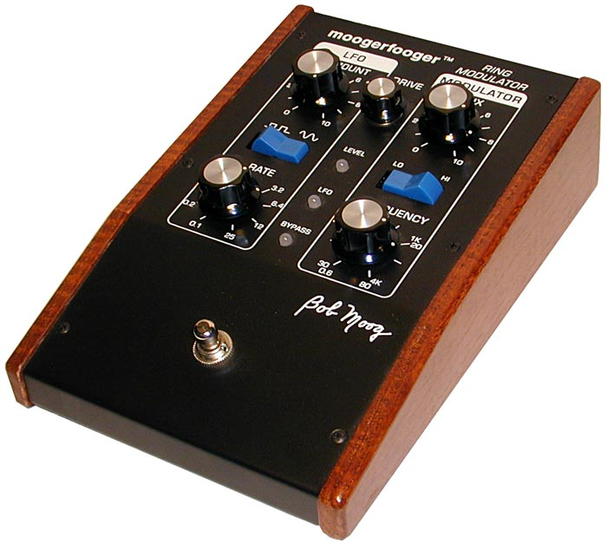
Modulation

Slide 2
Tremolo
Periodically vary amplitude of signal
Compared to vibrato which varies pitch
Multiply input signal by sinusoid: y(t)=[1+α sin(ω_{L}t) ]x(t)
α gives depth
usually ranges from 0 to 1
ω_{L} gives LFO (tremolo) frequency
Normal tremolo frequencies in range 0-10Hz

Slide 3
Tremolo applied to audio signal, varying depth

Slide 4
Tremolo artifacts- changing LFO frequency
for (n = 0; n<nSamples; n++) {
m[n]= 1 + alpha*cos(2*pi*f*n/fs);
y[n] = m[n]*x[n];
}
phase = 0;
for (n = 0; n<nSamples; n++) {
m[n]= 1 + alpha*cos(phase);
y[n]= m[n]*x[n];
phase = phase + 2*pi*f/fs;
}

Slide 5
Tremolo code example
In processBlock
auto numOutputChannels = getTotalNumOutputChannels();
auto numInputChannels = getTotalNumInputChannels();
float depth = 0.01f * depthParam->get();
float lfoFrequency = lfoFrequencyParam->get();
int lfoType = lfoTypeParam->getIndex();
float sampleRate = (float) juce::AudioProcessor::getSampleRate();
for (int i = 0; i < buffer.getNumSamples(); ++i) {
float amount = getLFOSample(lfoPhase, lfoType);
for (int j=0; j<numInputChannels; ++j) buffer.getWritePointer(j)[i]
= buffer.getReadPointer(j)[i] * (1.0f - depth * amount);
lfoPhase += lfoFrequency / sampleRate;
while (lfoPhase >= 1.0) lfoPhase -= 1.0;
}

Slide 6
Amplitude modulation (AM)
What happens when tremolo frequency ω_{L} approaches audio range?
Consider sinusoidal input: x(t)=A_{c}sin(ω_{c}t+φ_{c})
y(t)=[1+ α sin(ω_{L}t) ]x(t)
x(t) is called carrier signal
sin(ω_{L}t) is modulating signal
Could also be more generic function in range [-1, 1]
α is modulation index (or AM index)
AM radio
Replace sin(ω_{L}t) with audio signal to transmit
Generally band-limited to 10kHz
ω_{c} is frequency of radio receiver (520-1710kHz)

Slide 7
Musical effect of amplitude modulation (AM)
y(t) = [1+ α sin(ω_{m}t) ]x(t) = [1+ α sin(ω_{m}t) ] A_{c}sin(ω_{c}t+φ_{c})
= x(t)+ α A_{c}sin(ω_{m}t) sin(ω_{c}t+φ_{c})
Output is sum of original signal & product of signal with carrier wave
Focus on simplified version of latter part: y_{m}(t)=sin(ω_{L}t) sin(ω_{c}t)
Trigonometric identity sin(A)sin(B)=[cos(A-B)- cos(A+B)]/2 , A=ω_{L}t & B=ω_{c}t
alternate form for modulator output x_{m}(t)= [cos[(ω_{L}-ω_{c})t]- cos[(ω_{L}+ω_{c})t]]/2
Notice: sum and difference frequencies!
Notes:
The modulated signal x_{a}(t) can be written as the sum of the unmodulated carrier wave plus the product of the carrier wave and the modulating wave:
x_{α}(t)= x₀(t) +α a_{m}(t)A_{c}sin(ω_{c}t+φ_{c})
Periodic amplitude modulation of this nature is often called the tremolo effect when ω_{m}<20π or so (<10 Hz).
Let's analyze the second term of this equation for the case of sinusoidal AM with α=1 and φ_{c}=φ_{m}=0 :
x_{m}(t)=sin(ω_{m}t) sin(ω_{c}t)
This is just multiplication of two sine waves (one for carrier, one for modulator), and this forms the basis for understanding ring modulation.

Slide 8
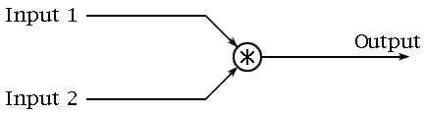

Ring modulator
Audio-frequency amplitude modulation
Multiply signal by a sinusoid
Suppressed-carrier modulation; drop the (1 + ) term before
Resulting frequencies will differ from input
Sum and difference frequencies (sidebands)
Output not harmonic
Sounds can be quite dissonant, even for simple inputs
Not widely used
Example:
guitar, then mixed with ring modulator output
Notes:
A ring modulator is a simple device that can be used to create unusual sounds from an instrument’s output. It takes two signals (each with some frequency), and produces a signal containing the sum and differences of those frequencies. These frequencies will typically be non-harmonic, so the ring modulator can create some very dissonant sounds. For this reason, ring modulation is not a widely used effect.
Sound Set 1: A phrase played on guitar, and then the same phrase played through a ring modulator (mixed together with the guitar's output).
How it Works
Modulation means that we are changing some aspect of a tone, such as it's amplitude, frequency, or phase. In the ring modulator, we are using amplitude modulation (more specifically, suppressed-carrier modulation) which is implemented simply by multiplying two signals. The figure depicts a simple flow diagram of a ring modulator which multiplies two input signals.
This multiplication results in a new signal that contains frequencies different than those of either of the original signals. More specifically, the multiplication results in an output that contains notes at the sum and difference of the two input signal's frequencies. These new frequencies are the sidebands - the sums are the upper sideband, and the differences are the lower sideband.

Slide 9
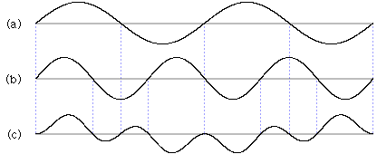
Not harmonic
Modulate with carrier frequency ω_{c}
Constant frequency added and subtracted from each partial
Frequencies no longer multiples of fundamental
Gong-like
ringing bells often contain strong non-harmonic components
400 Hz, 600 Hz sine wave, and product of the two
1000Hz High frequency added on top of 200Hz low frequency
200Hz component gives the waveform the gentle dip and rise
Notes:
This is not a harmonizer - in general, the notes produced by the ring modulator are not related to the inputs by some musical interval or harmonic relationship. Thus, the sound produced is very dissonant and harsh. This sound is often described as being 'gong-like' (bells often contain strong non-harmonic components when ringing). Figure 2 shows a segment of a 400 Hz, a 600 Hz sine wave, and the product of the two. Looking at the multiplied signals, we can see the higher frequency component (at 1000 Hz) added on top of the lower frequency component (at 200 Hz). This 200 Hz component gives the waveform the gentle dip and rise in the figure. This audio example is an of this case. Figure: (a) 400 Hz sine wave, (b) 600 Hz sine wave, and (c) the product of the two (a 200 Hz and 1000 Hz sine wave added together). The product is zero when either wave is zero.
Sound Set: A pure tone at 400 Hz, followed by a 600 Hz tone (a fifth higher), and then the result of the tones multiplied - a 200 Hz and 1000 Hz tone.
NOTE: You may need to use a pair of headphones to hear the true effect

Slide 10
Multiplying sinusoids at 400Hz and 100Hz results in sum and difference components at 500Hz and 300Hz, respectively.

Slide 11


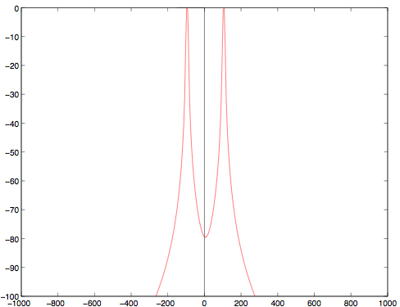
Frequency domain
Duality of multiplication and convolution
Convolution in time domain is multiplication in frequency domain:
Same is true in reverse:
Ring modulation is frequency-domain convolution with carrier spectrum
Magnitude (dB)
Frequency (Hz)

Slide 12
An example convolution of input and carrier signals.

Slide 13
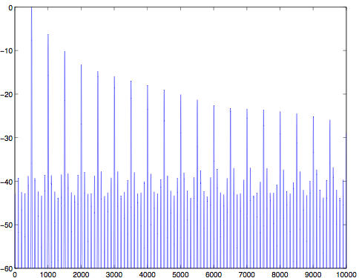
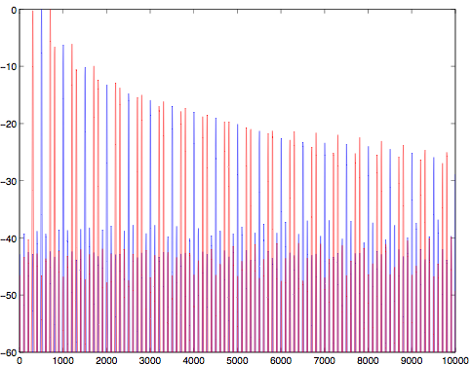
Frequency domain
Original signal (500Hz sawtooth)
Ring modulated: 200Hz carrier
Magnitude (dB)
Magnitude (dB)
Magnitude (dB)
Magnitude (dB)
Frequency (Hz)
Frequency (Hz)
Frequency (Hz)
Frequency (Hz)

Slide 14
Implementation
Ring modulator effects have one input for instrument
Other signal created by internal oscillator
Signal doesn’t appear in output directly (suppressed carrier)
Frequency usually adjustable
Instrument is sum of many sine waves
M instrument partials, N carrier partials...
2*M*N output partials (assuming no overlaps)
Ring modulator output alone may be unsuitable
Strange timbres result
Mix with original instrument sound
Blues riff
→processed by ring modulator using 100 Hz tone (with overtones)
→repeated while mixing in original instruments input
→repeated with 220 Hz oscillator
Notes:
Many of the ring modulators you encounter will only have one input for connecting an instrument. The other signal is usually created with some internal oscillator (which is generally considered to be the carrier signal. This signal doesn't appear in the output, hence the name 'suppressed carrier'). In some cases, you may be able to select the frequency of that oscillator, and in others, the frequency may be fixed at some value, or limited to a set of different values. But there's no reason why both signals couldn't be instruments, or why they both couldn't be oscillators for that matter.
Of course, an instrument's sound is usually considered as being a sum of many different sine waves, not a pure tone. And the oscillator used could also generate a complex waveform as well. The number of tones grows quickly as each component produces the sum and difference with all the partials in the other signal, creating a very complex sound.
The ring modulator's output alone may be totally unsuitable depending on one's tastes, but the sound can be smoothed a bit by simply mixing in the original instrument sound. This will give an instrument a strange timbre. The sound example presents some mixed ring modulator sounds.
Sound Set: A simple blues riff dry, and then processed by a ring modulator using a 100 Hz tone (with overtones). This same sound is repeated while mixing in the original instruments input, and then repeated with a 220 Hz oscillator.

Slide 15

Digital implementation
Analogue multiplication is actually quite expensive
Digital implementation is simple
Multiply sample-by-sample (1 multiplication per sample)
Watch out for aliasing
Highest frequency component is sum of two highest input component frequencies
Oversampling or pre-filtering can help avoid aliasing
Four-Quadrant Multiplier
£19
Notes:
Analog Implementation-Implementing amplitude modulation in the analog world is not always an easy thing to do. One implementation consists of a ring of four diodes (hence the name 'ring modulator') and a pair of transformers. This is also referred to as a lattice-type modulator, and it can actually be constructed as a passive circuit. Alternatively, a four-quadrant multiplier can be used, which is commonly available as an integrated circuit package.
Digital Implementation-Creating a digitally based ring modulator comes down to simply multiplying two numbers each sampling interval which is very easy to accomplish. However, there needs to be some consideration about the signals used as aliasing can create a noisy output. The highest frequency component in the output is the sum of the highest components in each of the signals being used. To deal with this aliasing, so it is common to oversample the operation or filter the signals prior to ring modulation.

Slide 16
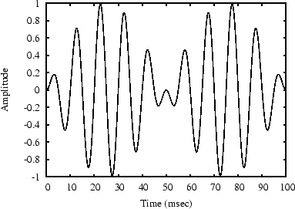
Ring Modulator sound
Sinusoidal amplitude modulation as in
x_{m}(t)=sin(ω_{m}t) sin(ω_{c}t)
f_{c}=100Hz and f_{m}=10 Hz
1 period of modulation=1/f_{m} seconds is shown
For ω_{m}<20π radians per second or 10 Hz
x_{m}(t) may be heard as beating sine wave
ω_{m}/π=2 f_{m} beats per second
positive & negative peaks of modulating sinusoid cause amplitude swell in x_{m}(t)
twice modulation frequency
Sign inversion at negative peaks not normally audible
Notes:
An example waveform is shown in the figure for f_{c}=100Hz and f_{m}=10 Hz.
When ω_{m} is small (say less than 20p radians per second, or 10 Hz), the signal x_{m}(t) is heard as a `beating sine wave’ with ω_{m}/π=2 f_{m} beats per second. The beat rate is twice the modulation frequency because both the positive and negative peaks of the modulating sinusoid cause an ``amplitude swell'' in x_{m}(t). One period of modulation—1/f_{m} seconds is shown in the figure. The sign inversion during the negative peaks is not normally audible.

Slide 17
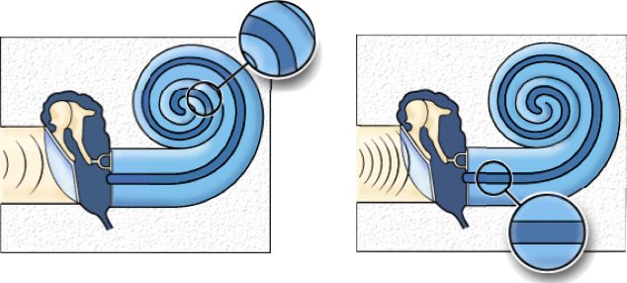
Sinusoidal modulation and hearing
Two ways to look at same signal:
Beating sinusoids: y_{m}(t)=sin(ω_{L}t)sin(ω_{c}t)
Sum of sidebands: y_{m}(t)= [cos[(ω_{L}-ω_{c})t]-cos[(ω_{L}+ω_{c})t]]/2
Mathematically identical; which do we hear?
Ear effectively performs short-time Fourier analysis of incoming sounds
Basilar membrane in cochlea acts as mechanical filter bank
Low Frequency
High Frequency
Notes:
These two sinusoidal components at the sum and difference frequencies of the modulator and carrier are called side bands of the carrier wave at frequency ω_{c} (since typically ω_{c}>>ω_{m}>0).
The previous equation expresses x_{m}(t) as a beating sinusoid, while the new equation expresses as it two unmodulated sinusoids at frequencies ω_{c}+-ω_{m}. Which case do we hear?
It turns out we hear x_{m}(t) as two separate tones (the second equation) whenever the side bands are resolved by the ear. The ear performs a ``short time Fourier analysis'' of incoming sound (the basilar membrane in the cochlea acts as a mechanical filter bank).

Slide 18
Sinusoidal modulation and hearing
Consider resolution of cochlear filter bank
When can two frequencies be separately perceived?
Related to critical bandwidth of hearing
For most of hearing range, critical bandwidth approx.15-20% of band centre frequency
3 cases for two sidebands
Separated by at least 1 critical bandwidth
Heard as two separate tones
Well inside same band
Heard as beating (amplitude variation) of single tone
Transition between these cases (around 1 critical band)
Heard as roughness, not clearly beating or separate tones
Notes:
The resolution of this filterbank--its ability to discern two separate spectral peaks for two sinusoids closely spaced in frequency--is determined by the critical bandwidth of hearing.
A critical bandwidth is roughly 15-20% of the band's center-frequency, over most of the audio range. Thus, the side bands in sinusoidal AM are heard as separate tones when they are both in the audio range and separated by at least one critical bandwidth. When they are well inside the same critical band, ``beating'' is heard. In between these extremes, near separation by a critical-band, the sensation is often described as roughness.

Slide 19
Ring modulator code example
In processBlock
auto numInputChannels = getTotalNumInputChannels();
auto numOutputChannels = getTotalNumOutputChannels();
float mix = mixParam->get();
float carrierFrequency = carrierFrequencyParam->get();
float sampleRate = (float) juce::AudioProcessor::getSampleRate();
for (int i = 0; i < buffer.getNumSamples(); ++i) {
float carrierSignal= sinf(juce::MathConstants<float>::twoPi * carrierPhase);
float in = (2.0f * rand() / RAND_MAX - 1.0f);
for (int j = 0; j < numOutputChannels; ++j)
buffer.getWritePointer(j)[i] = (1.0-mix) * in + mix * in * carrierSignal;
carrierPhase += carrierFrequency / sampleRate;
while (carrierPhase >= 1.0) carrierPhase -= 1.0;
}

Slide 20
FM Synthesis

Slide 21
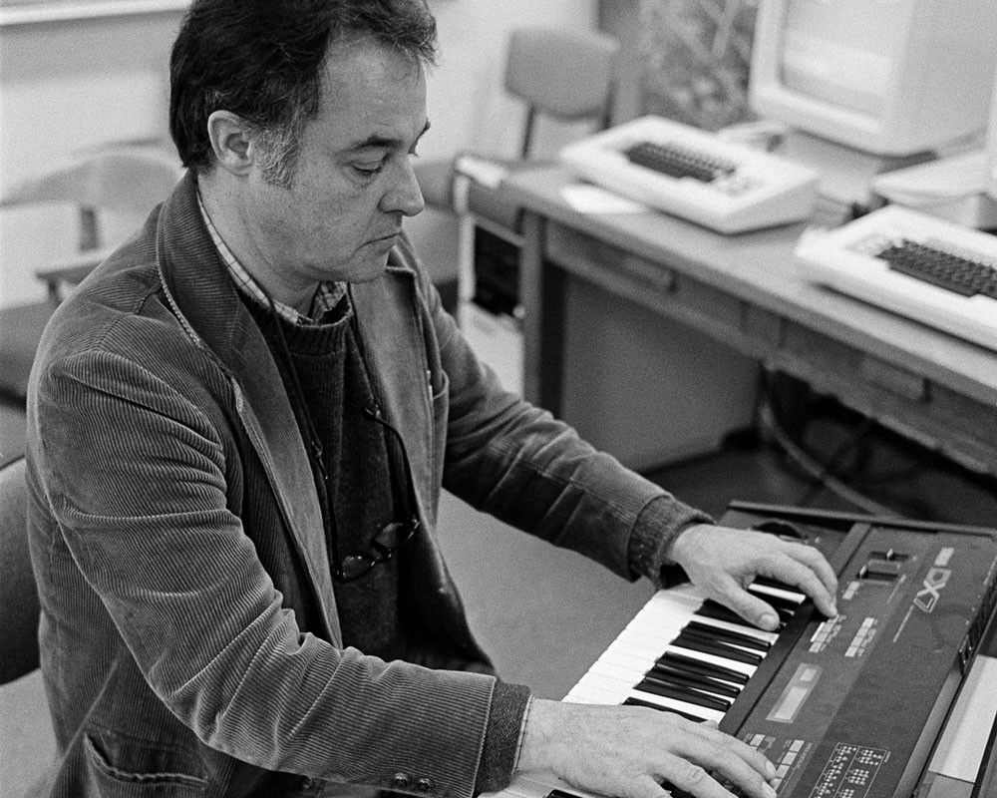
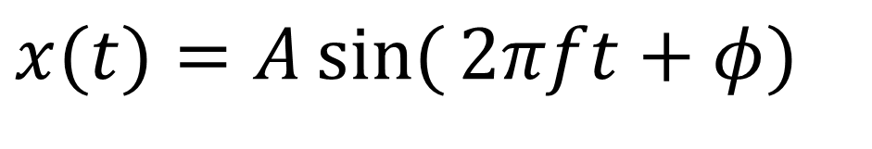
FM synthesis
Modulation - varying properties of periodic waveform, the carrier signal, with a modulating signal.
FM synthesis - Creating sound by modulating the frequency of a waveform using another waveform
Chowning, John M. "The synthesis of complex audio spectra by means of frequency modulation." Journal of the audio engineering society 21.7 (1973): 526-534.
Vary A – Amplitude modulation
Vary f – Frequency modulation
Vary φ – Phase modulation
$$x(t)=A\sin{(}2πft+φ)$$

Slide 22
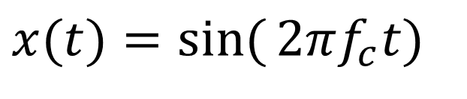


Frequency modulation synthesis
Simple sine wave
x(t) – the carrier
f _{c} – carrier frequency, or frequency offset, gives fundamental frequency
Now modulate the frequency
f (t) – the modulator
f _{m} –modulation frequency
D – modulation depth
Chowning originally did phase modulation
$$x(t)=\sin{(}2πf_{c}t)$$
$$f(t)=D\sin{(}2πf_{m}t) \\ →x(t)=\sin{(}2π(f_{c}+f\left(t\right))t) \\ =\sin{(}2π(f_{c}+D\sin{(}2πf_{m}t))t)$$
$$f(t)=D\sin{(}2πf_{m}t) \\ →x(t)=\sin{(}2π{(f}_{c}t+f(t))) \\ =\sin{(}2π(f_{c}t+D\sin{(}2πf_{m}t)))$$
Notes:
See https://www.eeeguide.com/theory-of-frequency-modulation-and-phase-modulation/
http://www.cs.cmu.edu/~music/icm-online/readings/fm-synthesis/fm_synthesis.pdf

Slide 23
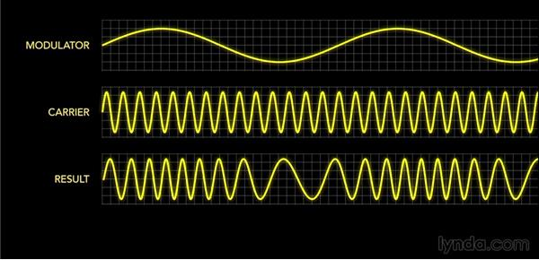
Example

